Slide 1
EPICS Automation
Kay Kasemir
July 2026

Slide 2
Control System
.. should support automated control.
How can EPICS do this?

Slide 3
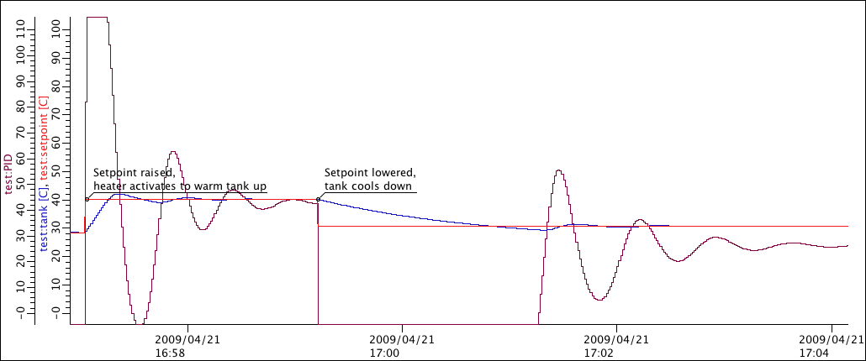
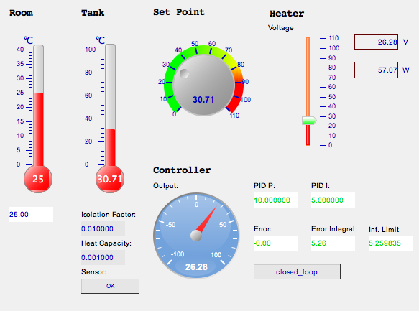
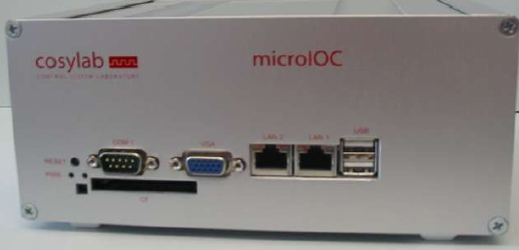
Monitoring, Supervisory Control
IOC
record(ai, “sensor”)
{
field(DTYP, “SensorXYZ”)
field(INP, “@bus1 signal2”)
field(SCAN, “1 second”)
..
record(ao, “voltage”)
{
field(DTYP, “PowerSupplyABC”)
field(OUT, “@bus2 signal4”)
field(SCAN, “Passive”)
..
User Interface
Channel Access
‘monitor’
Channel Access
‘put’

Slide 4
Automation via Records on IOC
IOC
record(ai, “sensor”)
{
field(DTYP, “SensorXYZ”)
field(INP, “@bus1 signal2”)
field(SCAN, “1 second”)
..
record(calcout, “control_voltage”)
{
field(INPA, “sensor CP”)
field(CALC, “A<10?5:0”)
field(OUT, “voltage PP”)
}
record(ao, “voltage”)
{
field(DTYP, “PowerSupplyABC”)
field(OUT, “@bus2 signal4”)
field(SCAN, “Passive”)
..
Data flow driven,
periodic,
steady-state control:
  Read inputs
  Compute desired outputs
    calcout to write ao.VAL
    calc, then use DOL and OMSL=closed_loop in ao
  Write outputs
Good for basic on/off as well as PID type of control

Slide 5
Distribute Records onto different IOCs
IOC
record(ai, “sensor”)
{
field(DTYP, “SensorXYZ”)
field(INP, “@bus1 signal2”)
field(SCAN, “1 second”)
..
record(ao, “voltage”)
{
field(DTYP, “PowerSupplyABC”)
field(OUT, “@bus2 signal4”)
field(SCAN, “Passive”)
..
IOC
record(calcout,
“control_voltage”)
{
field(INPA, “sensor MS CP”)
field(CALC, “A<10?5:0”)
field(OUT, “voltage PP”)
field(IVOA, “Don’t drive outputs”)
}
Channel
Access
Almost no additional work!
Anticipate network issues;
see ‘MS’, ‘IVOA’

Slide 6
Automation via State Machine
IOC
record(ai, “sensor”)
{
field(DTYP, “SensorXYZ”)
field(INP, “@bus1 signal2”)
field(SCAN, “1 second”)
..
record(ao, “voltage”)
{
field(DTYP, “PowerSupplyABC”)
field(OUT, “@bus2 signal4”)
field(SCAN, “Passive”)
..
Start
Low reading
sensor > 5
Set voltage to …
High reading
Sensor < 5
Set voltage to …
“Sequencer”, “State Notation Language”:
Event driven, on-demand, stateful

Slide 7
Automation via Scripts
IOC
record(ai, “sensor”)
record(ao, “voltage”)
#!/usr/bin/env python
from epics import caget, caput
import time
while True:
  sensor = caget(“sensor”)
  voltage = 5 if sensor < 10 else 0
  caput(“voltage”, voltage)
  time.sleep(1.0)
Channel Access
Tempting, but
  Error Handling?
  caget? caput?
    Monitor; Connect once, then re-use the connection
    (PyEpics actually does this)
  Handle disconnects, re-connects
Should have ‘console’, run under procServ
  IOC has shell
Long-term maintenance of “Fred’s script”?
  Calc record has CALC, SCAN, INPA, ..

Slide 8
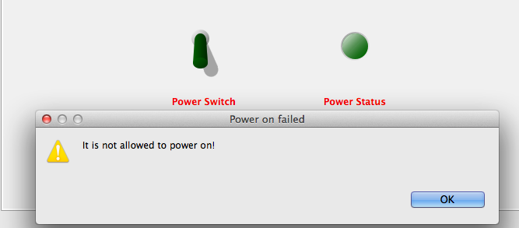
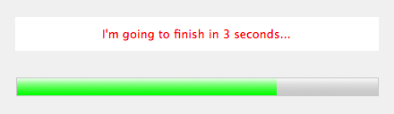
Automation via User Interface?
IOC
record(ai, “sensor”)
record(ao, “voltage”)
Channel Access
Check allowed values?
  What if other CA client writes to PV?
  Use DRVH, DRVL, calc records, .. to perform check on IOC, not in each user interface
Automation scripts?
  What if users open multiple user interfaces?
  What if GUI crashes (which is more likely than IOC)?
Keep user interface as just that!

Slide 9
Automation with EPICS
Records
  Steady-data, data flow driven operations
  Continuous: Read input, compute, write output
  Limited conditional processing: calcout.OOPT
State Notation Language
  On-demand, event driven
  Stateful: In State X, if Y happens, ..
Scripts
  Useful for “I need this just once, but I need it now”
  Permanent “Python IOCs” require effort similar to IOCs
Automation via Operator Interface
  UI should never do anything

